Slide 1

Forecasting U.S. flight Traffic
Business Forecasting 22:544:608:60
Final Project
Sumin Oh
so518@scarletmail.rutgers.edu

Slide 2
AGENDA
Purpose of Forecasting
About this Data
Exploratory Data Analysis
Box Plot & Histogram
ACF
Decomposition
Accuracy Measure Decision
Forecasting & Residual Analysis
Naïve
Simple Moving Average
Simple Smoothing
Holt-Winters
ARIMA
Time series Regression
Accuracy Summary & Decision
To improve…

Slide 3

1. Purpose of forecasting
In this project, the number of passengers for the next 1 year, which is Y2024, will be predicted. Covid restricted passenger to use flights, but the number is recovering gradually after its drastic drop in 2020.
This project is to forecast the total number of passengers using various forecast methods and compare the accuracy of those models to find out the best methods.

Slide 4
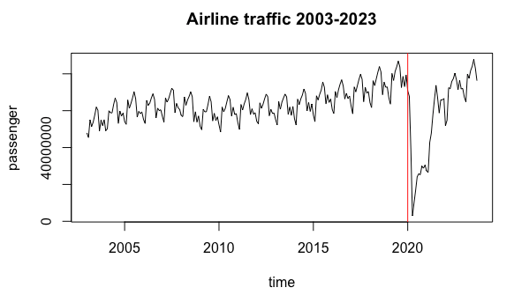

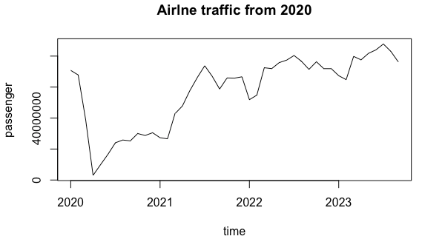
2. About this data
This dataset provides U.S. monthly airline traffic from 2003 to 2023
Due to the Covid19 outbreak in 2020, there was a significant drop in the traffic. For the accurate forecast, data was cut from 2020~2023 to be utilized.

Slide 5
3
EXPLORATORY DATA ANALYSIS

Slide 6
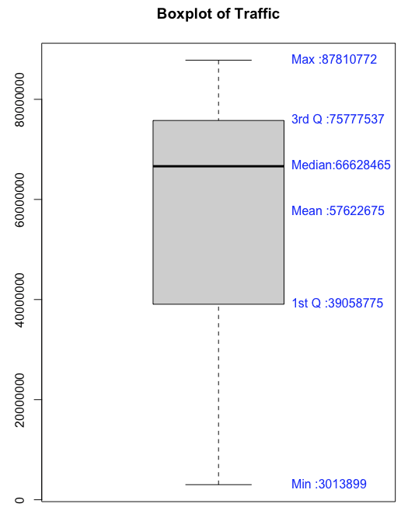
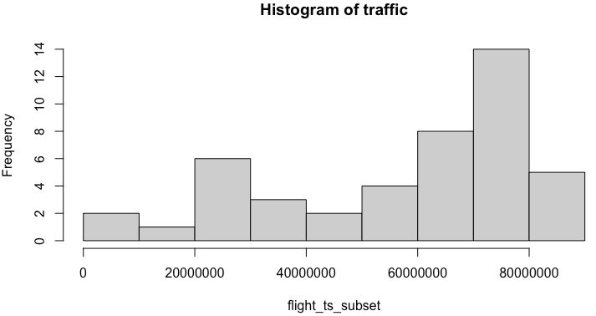
(1)box plot & histogram
Vast range of the data, with the most of values located between 60M-80M
Slightly Skewed to left
Median is closer to 3rd Quartile than 1st Quartile
IQR = 36,718,762
No outliers detected

Slide 7
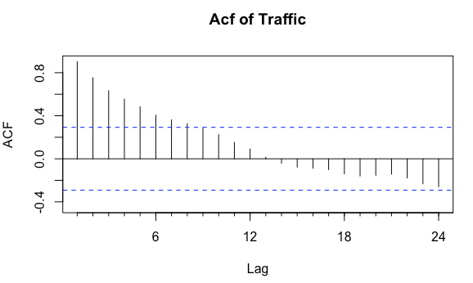

(2) acf
Trend
Initial lags show high ACF values, with gradually decreasing figure. This means that data has a trend component.
Seasonality
No significant peak on specific lag such as 12 or 24. Considering this is monthly data, there is a possibility that there is no big seasonality in this dataset.

Slide 8
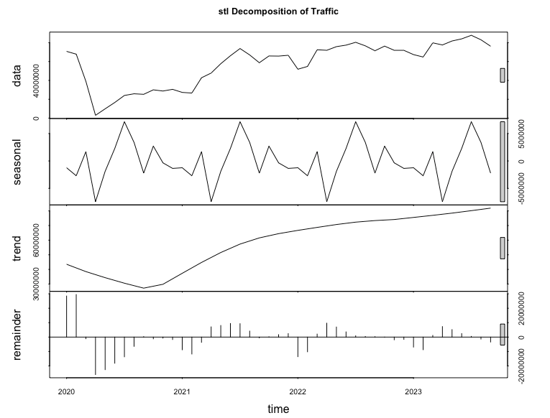
(3) decomposition
Trend
The data trend shows a slowdown in early 2020 and an increase in 2021. This recent trend has been confirmed in 2022 and beyond, suggesting that the data is recovering and growing correctly.
Seasonality
In this decomposition method, strong seasonality was detected, unlike in Acf analysis. It can be assumed that there may be some seasonality in the data but will not be central to explain the main patterns in data.
Residuals
Since the residuals are mostly randomly distributed, we can see that seasonality and trend explains the main patterns in the data well.

Slide 9
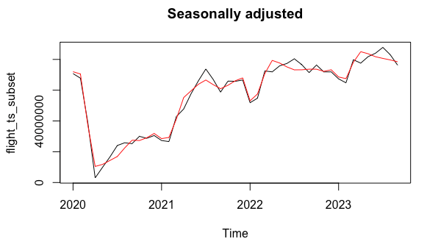
(3) decomposition
When seasonality was removed(red line), the main patterns remained largely unchanged.
This indicates that the influence of seasonality on the data is relatively weak.
The main patterns of the data are primarily explained by trends.
Even without seasonality, the trends are still clearly visible.
Trends are the most significant factor in explaining the data and play a key role in data analysis.

Slide 10
(3) Accuracy measure decision
Chosen Accuracy Measure(In order)
MAE(Mean Absolute Error)
Evaluates all errors equally and shows the absolute error size of the data.
Maintains the units of the data, so the interpretation is intuitive.
Easy to understand the size of the average error in predictions.
RMSE (Root Mean Squared Error)
Sensitive to large errors and focuses more on errors that occur at large values.
Useful when focusing on large errors in trend-based data.
MAPE (Mean Absolute Percentage Error)
Intuitively understandable because the prediction error is expressed as a % regardless of the size of the value.
Identified Data Characteristics
Trend seems to have impact on the Data
Has a Seasonality, but not very strong
Size of data is quite big (Maximum 87M)

Slide 11
4
FORECASTING & RESIDUAL ANALYSIS

Slide 12
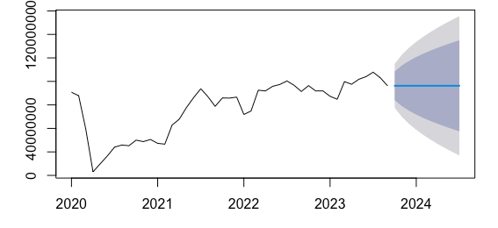
(1) Naïve method – forecast
Naïve method predicts the value of the whole forecasting period as same as the last value in the data, which is 76,251,475

Slide 13
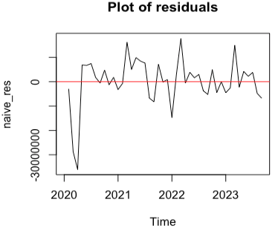
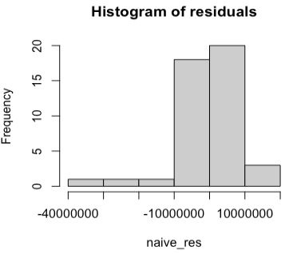
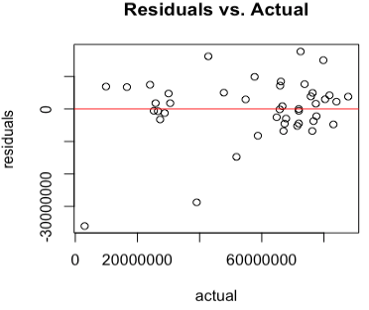
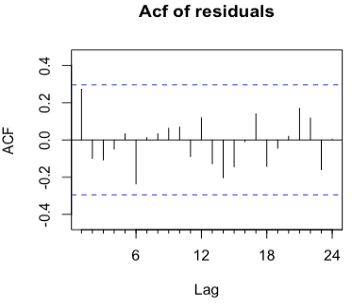
(1) Naïve method – residual analysis
Generally describes the underlying trend and variability of the data well, and the residuals are generally evenly distributed around zero.
However, since the distribution of the residuals is slightly asymmetric, the naive method alone has limitations in explaining all the patterns in the data.

Slide 14
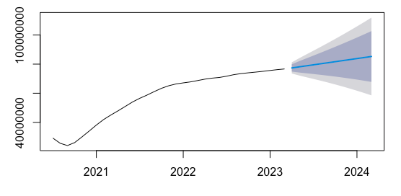
(2) Simple moving average method – forecast
Moving average reflecting 12 months of data
This is used when wants to see long term trends, but may not be suitable to model the seasonality or volatility.

Slide 15
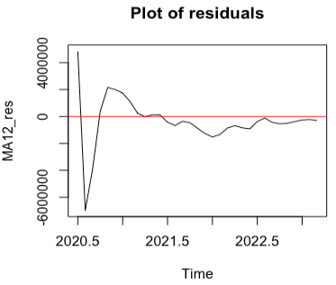
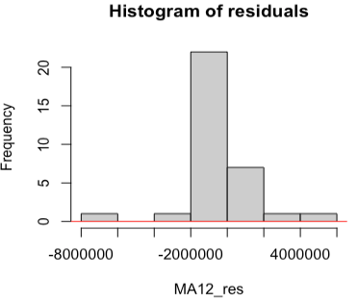
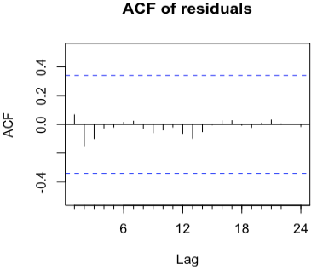
(2) Simple moving average method – residual analysis
The moving average model effectively reflects the main patterns (trends and seasonality) of the data.
The residuals are mostly distributed around 0 and show a form close to normality.
The ACF analysis results show that there is no clear autocorrelation in the residuals, so it can be said that the model explains the data well.

Slide 16
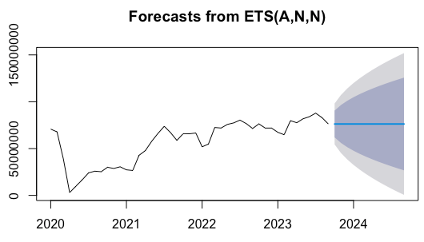
(3) simple smoothing method – forecast
Simple smoothing uses a weighted average of past data to calculate the current value without considering Trend and Seasonality.
Simple and intuitive, however, may not be suitable for long term forecasting.

Slide 17
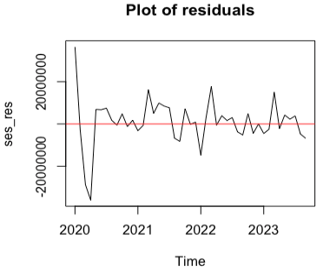
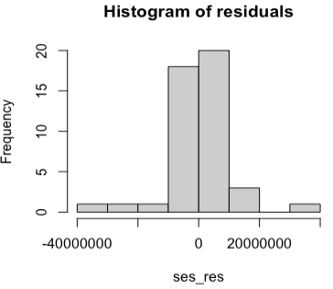
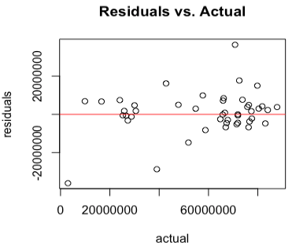
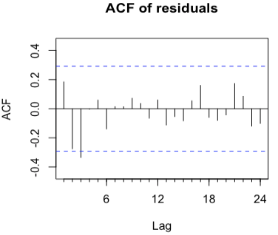
(3) simple smoothing method – residual analysis
The Simple smoothing model effectively reflects the main patterns (trends and seasonality) of the data.
The residuals are mostly distributed around 0 (but not as much as Moving Average) and show a form close to normality.
The ACF analysis results show that autocorrelation in the residuals is minimal, so it can be said that the model explains the data well.

Slide 18
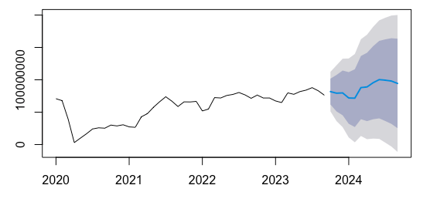
(4) Holt-winters method – forecast
It is an extended form of Exponential Smoothing that reflects both Trend and Seasonality of time series data for forecasting.
It is mainly used for forecasting data with seasonal variation.

Slide 19
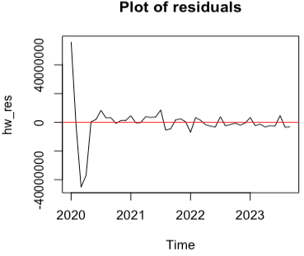
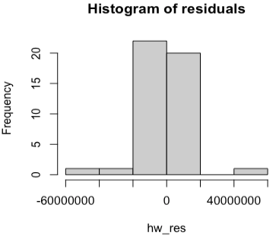
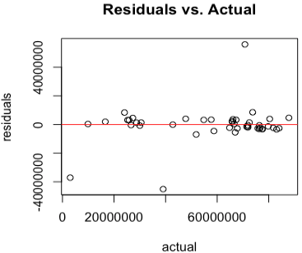
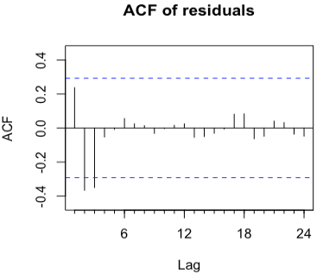
(4) Holt-winters method – residual analysis
The Holt-Winters model does a good job of explaining complex data that includes both trends and seasonality.
The residuals are roughly randomly distributed around 0 without patterns, and there is no autocorrelation, so the model is considered to be suitable.
There are some lags exceeding the confidence interval range, but it’s minimal.

Slide 20
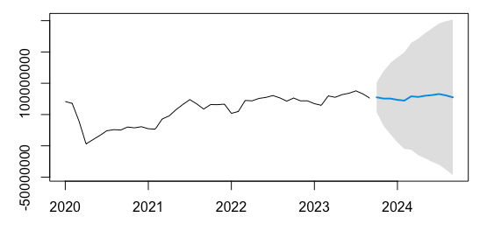
(5) ARIMA method – forecast
It models data by combining three components: AutoRegressive (AR), Integrated (I), and Moving Average (MA).
The ARIMA model predicts based on the residuals remaining after removing trends and seasonality.
It reflects trends and patterns well and is strong against non-seasonal data

Slide 21
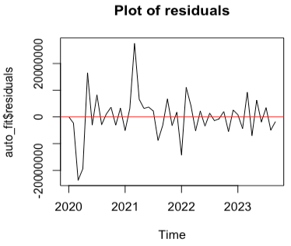
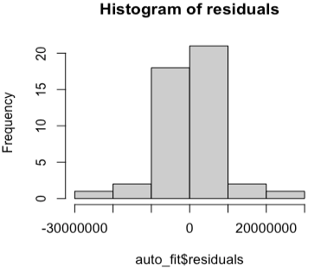
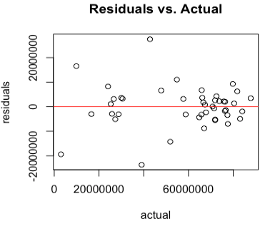
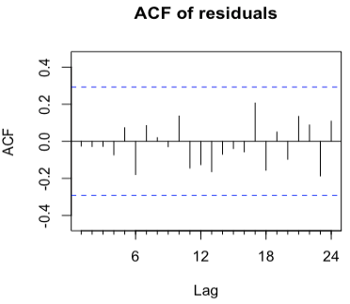
(5) ARIMA method – residual analysis
The ARIMA model explains the data well and the residuals are randomly distributed.
The results of the ACF analysis show that there is almost no autocorrelation in the residuals, so it is judged that the model reflects the data pattern well.

Slide 22
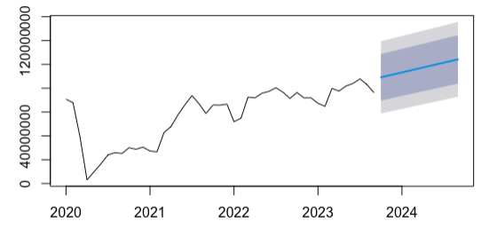
(6) Time series Regression – forecast
It performs linear regression on time series data and explain trends and seasonality of data.
This time, only Trend was included to predict.

Slide 23
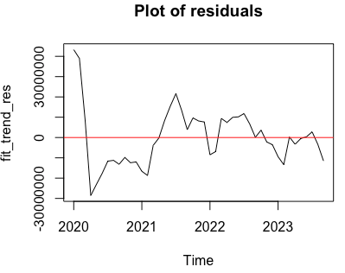
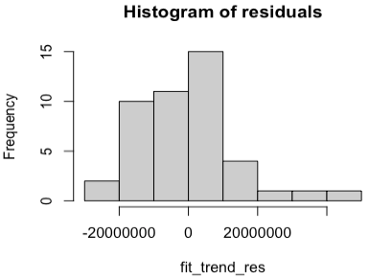
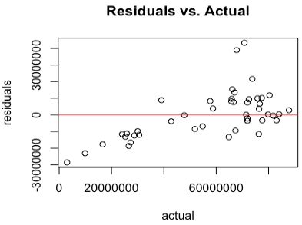
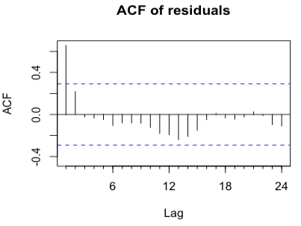
(6) Time series Regression– residual analysis
The Regression model is considered to be suitable because the residuals are generally normal and randomly distributed, and there is little autocorrelation.

Slide 24
5
ACCURACY SUMMARY & DECISION

Slide 25



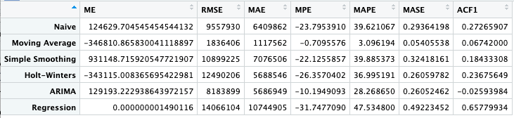
5. Accuracy measure ranking & decision
MAE
Moving Average
ARIMA
Holt-Winters
RMSE
Moving Average
ARIMA
Simple-Smoothing
MAPE
Moving Average
ARIMA
Holt-Winters

Slide 26
6
TO IMPROVE THE RESULT…

Slide 27
6. To improve the result
Is selecting Moving Average the best choice?
Moving averages simply shows the average tendency of the data and does not reflect complex seasonality or trends. It is best suited to exploit stable patterns in data in short-term forecasting situations and is not suitable for long-term predictions and may degrade as data patterns change.
Now, the purpose is to predict 1 year traffic, and this data does not include strong seasonality.
So, it’s suitable to use Moving Average.
To have better result..
Select moving average as the basic model, but at the same time use ARIMA or Holt-Winters as a complement when data patterns change or the forecast period becomes longer.

